Slide 1
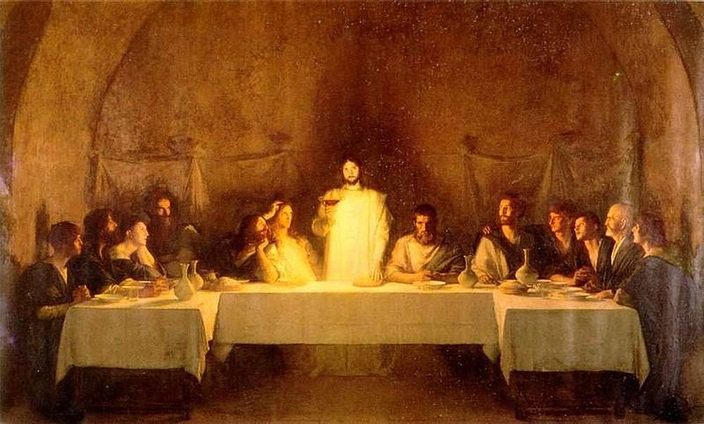
Chapter 15: The Sacrament of the Lord’s Supper
“As Jesus took the bread and broke it, and took the cup and blessed it, he was presenting himself as the Lamb of God who would provide spiritual nourishment and eternal salvation.”

Slide 2
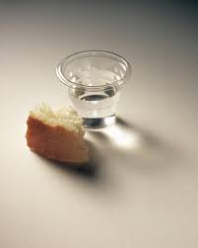
From the Life of Howard W. Hunter
"As I have listened to him ask our Heavenly Father to bless the sacrament, I have felt of the deep spirituality in his soul. Every word was clear and meaningful. He was not in a hurry, not rushed. He was the spokesman for all of the Apostles in addressing our Heavenly Father"

Slide 3
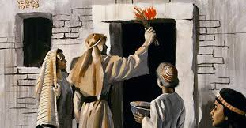
The Passover declares that death has no permanent power on us.
The Passover [and Easter] testify of the great gift God has given and of the sacrifice that was involved in its bestowal. Both of these great religious commemorations declare that death would “pass over” us and could have no permanent power upon us, and that the grave would have no victory.

Slide 4
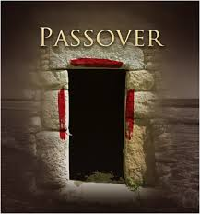
“That ye shall say, It is the sacrifice of the Lord’s passover, who passed over the houses of the children of Israel in Egypt.”

Slide 5
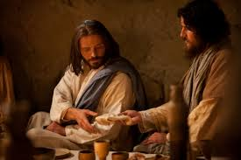
During a feast commemorating the Passover, the Savior instituted the ordinance of the sacrament.
Christ here introduced the symbols that would later have even greater meaning in the Upper Room. “I am the bread of life,” he said. “He that cometh to me shall never hunger; and he that believeth on me shall never thirst.” (John 6:35.)

Slide 6
"He taught them a newer and holier meaning of that ancient blessing from God."
“Ye know that after two days is the feast of the passover, and the Son of man is betrayed to be crucified.” (Matt. 26:1–2.)
Knowing full well what awaited him, Jesus asked Peter and John to make arrangements for the paschal meal. He told them to ask of the master of a local house, “Where is the guestchamber, where I shall eat the passover with my disciples?” (Luke 22:11.)

Slide 7
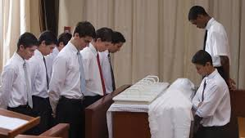

Slide 8
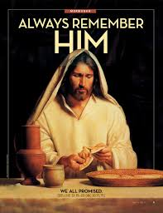
In this simple but impressive manner the Savior instituted the ordinance now known as the sacrament of the Lord’s Supper. With the suffering of Gethsemane, the sacrifice of Calvary, and the resurrection from a garden tomb, Jesus fulfilled the ancient law and ushered in a new dispensation based on a higher, holier understanding of the law of sacrifice. No more would men be required to offer the firstborn lamb from their flock, because the Firstborn of God had come to offer himself as an “infinite and eternal sacrifice.”

Slide 9
Our participation in the sacrament is an opportunity to review our lives and renew our covenants.
Having attended sacrament meeting and partaken of the sacrament made the day more meaningful, and I felt that I better understood the reason why the Lord said, “And that thou mayest more fully keep thyself unspotted from the world, thou shalt go to the house of prayer and offer up thy sacraments upon my holy day.
“For verily this is a day appointed unto you to rest from your labors, and to pay thy devotions unto the Most High.” (D&C 59:9–10.)

Slide 10
