Slide 1
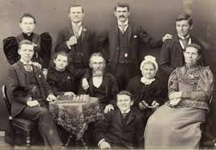
Chapter 14: Hastening Family History and Temple Work
“Surely the Lord will support us if we use our best efforts in carrying out the commandment to do family history research and temple work.”

Slide 2
From the Life of Howard W. Hunter
Family history was always close to President Howard W. Hunter’s heart.
He and his wife, Claire, visited places in Denmark where his ancestors had lived. In one of the villages, they found the church where President Hunter’s great-grandfather Rasmussen had been christened and where the family had worshipped. This experience deepened President Hunter’s appreciation for his maternal ancestors. He made similar visits to areas of Norway and Scotland where other ancestors had lived.

Slide 3
I look back in wonder at the tapestry woven by the Lord in the furthering of temple and family History Work.
When I was president of the Genealogical Society of Utah, we had visions of how it would move forward mightily. Now we are observing something glorious occurring throughout the world. The gospel is moving forward to encompass every nation, kindred, tongue, and people. Temples are located throughout the earth, and the spirit of Elijah is touching the hearts of many members, who are doing family history and temple ordinance work at an unprecedented pace.ily history work

Slide 4
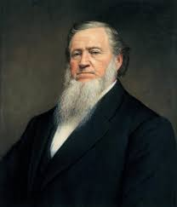
Temples are built for performing ordinances that are essential for the salvation and exaltation of God’s children.
The gospel proclaimed to the world by the Latter-day Saints is the gospel of Jesus Christ as restored to the earth in this dispensation and is for the redemption of all mankind. The Lord himself has revealed what is essential for the salvation and exaltation of his children.
President Brigham Young said: Let me give you a definition in brief. Your endowment is, to receive all those ordinances in the house of the Lord, which are necessary for you, after you have departed this life, to enable you to walk back to the presence of the Father, passing the angels who stand as sentinels (DBY, 416).

Slide 5
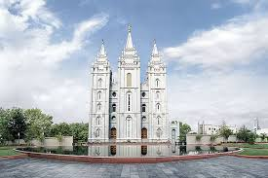
The question these people most frequently ask is, what are the ordinances that are performed in temples?

Slide 6
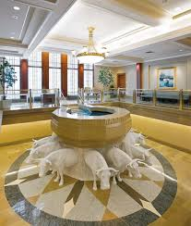
Baptism for the dead
“Verily, verily, I say unto thee, Except a man be born of water and of the Spirit, he cannot enter into the kingdom of God” (John 3:5)“Else what shall they do which are baptized for the dead, if the dead rise not at all? why are they then baptized for the dead?” (1 Cor. 15:29.)

Slide 7
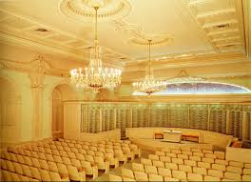
The endowment
It consists of two parts: first, a series of instructions, and second, promises or covenants that the person receiving the endowment makes - promises to live righteously and comply with the requirements of the gospel of Jesus Christ.-

Slide 8
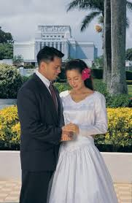
Celestial marriage
Another temple ordinance is that of celestial marriage, where wife is sealed to husband and husband sealed to wife for eternity.Children born to a husband and wife after an eternal marriage are automatically sealed to their parents for eternity.

Slide 9
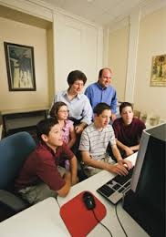
The objective of family history work is to make the blessings of the temple available to all people.

Slide 10
The building of temples has deep significance for ourselves and mankind, and our responsibilities become clear. We must accomplish the priesthood temple ordinance work necessary for our own exaltation; then we must do the necessary work for those who did not have the opportunity to accept the gospel in life.

Slide 11
I have learned that those who engage in family history research and then perform the temple ordinance work for those whose names they have found will know the additional joy of receiving both halves of the blessing.
Furthermore, the dead are anxiously waiting for the Latter-day Saints to search out their names and then go into the temples to officiate in their behalf, that they may be liberated from their prison house in the spirit world. All of us should find joy in this magnificent labor of love

Slide 12
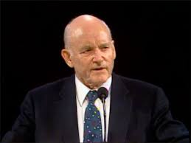
May we be valiant in hastening our family history and temple work.
"This sacred work has a prominent place in the hearts and minds of the First Presidency and Quorum of the Twelve. I speak for all of the Brethren when I thank those who have given valuable contributions in providing the saving ordinances for those beyond the veil. … We are grateful to the army of volunteers who move this mighty work forward throughout the world. Thank you all for what you are doing so well."

Slide 13
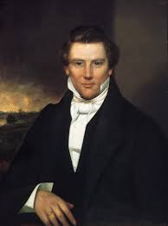
The Prophet Joseph Smith stated, “The greatest responsibility in this world that God has laid upon us is to seek after our dead” “Those Saints who neglect it in behalf of their deceased relatives, do it at the peril of their own salvation”

Slide 14
Statistics by President Howard W Hunter
Last year [1993] we performed proxy temple endowments for about five and a half million persons, but during that year about fifty million persons died. This might suggest futility in the work that lies before us, but we cannot think of futility. Surely the Lord will support us if we use our best efforts in carrying out the commandment to do family history research and temple work.

Slide 16
“Let the work of my temple, and all the works which I have appointed unto you, be continued on and not cease; and let your diligence, and your perseverance, and patience, and your works be redoubled, and you shall in nowise lose your reward, saith the Lord of Hosts” (D&C 127:4).

Slide 17
I encourage you in your efforts with these words of the Prophet Joseph Smith: “Brethren, shall we not go on in so great a cause? Go forward and not backward. Courage, brethren; and on, on to the victory! Let your hearts rejoice, and be exceedingly glad.

Slide 18
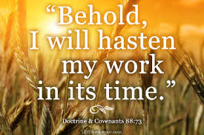
Hastening the work

