Slide 1
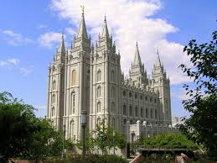
Chapter 13: The Temple—The Great Symbol of Our Membership
“It is the deepest desire of my heart to have every member of the Church worthy to enter the temple.”

Slide 2
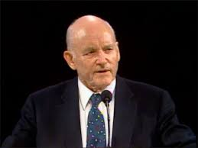
From the Life of Howard W. Hunter
...when Howard W. Hunter made his first public statement as President of the Church, one of his primary messages was for members to seek the blessings of the temple with greater devotion. "Temple worthiness ensures that our lives are in harmony with the will of the Lord, and we are attuned to receive His guidance in our lives.”

Slide 3
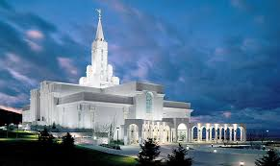
In January 1995, President Hunter’s last public activity was the dedication of the Bountiful Utah Temple. In the dedicatory prayer, he asked that the blessings of the temple would enrich the lives of all who entered:

Slide 4
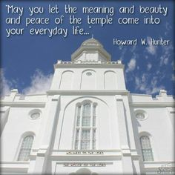
"We humbly pray that thou wilt accept this edifice and let thy blessings be upon it. Let thy spirit attend and guide all who officiate herein, that holiness will prevail in every room. May all who enter have clean hands and pure hearts."

Slide 5
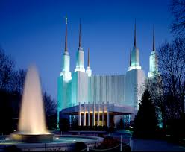
We are encouraged to establish the temple as the great symbol of our membership.

Slide 6
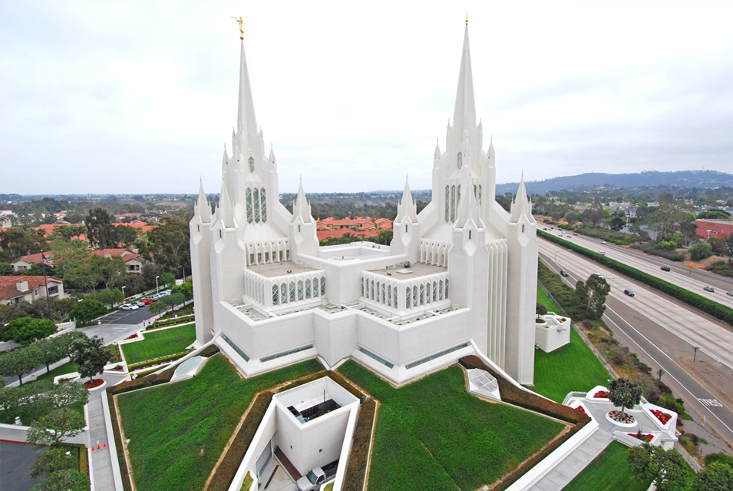
PLACE OF INSTRUCTION
The temple is a place of instruction where profound truths pertaining to the Kingdom of God are unfolded.

Slide 7
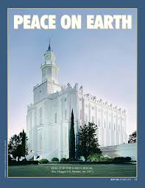
Place of peace

Slide 8
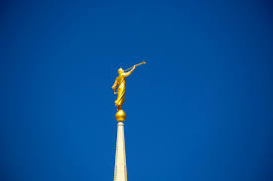
In the temple we make covenants to obey the laws of God
Promises are made to us, conditioned always on our faithfulness, which extend into eternity

Slide 9
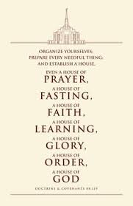
Are these attitudes and behaviors indeed reflective of what each of us desires and seeks to be? …

Slide 10
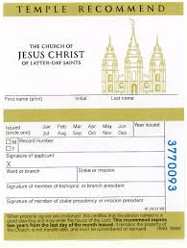
Each of us should strive to be worthy to receive a temple recommend.
The things that we must do and not do to be worthy of a temple recommend are the very things that ensure we will be happy as individuals and as families.

Slide 11
You should know what is expected of you in order to qualify for a temple recommend.
You must believe in God the Eternal Father, in his Son Jesus Christ, and in the Holy Ghost.
You must sustain the General Authorities and local authorities of the Church.
You must be morally clean to enter into the holy temple.
To qualify for a temple recommend, you should strive to do your duty in the Church, attending your sacrament, priesthood, and other meetings.
To enter the temple you must be a full-tithe payer and live the Word of Wisdom.

Slide 12
Doing temple work brings great blessings to individuals and families.
Several things are accomplished by our attendance at the temple—we comply with the instructions of the Lord to accomplish our own ordinance work, we bless our families by the sealing ordinances, and we share our blessings with others by doing for them what they cannot do for themselves. In addition to these, we lift our own thoughts, grow closer to the Lord, honor [the] priesthood, and spiritualize our lives

Slide 13
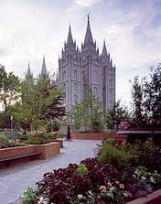
Let us hasten to the temple.
Let us be a temple-attending and a temple-loving people. Let us hasten to the temple as frequently as time and means and personal circumstances allow. Let us go not only for our kindred dead, but let us also go for the personal blessing of temple worship, for the sanctity and safety which is provided within those hallowed and consecrated walls.

