Slide 1
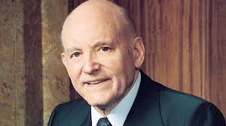
Chapter 12: Come Back and Feast at the Table of the Lord
“Reach out to the less active and realize the joy that will come to you and those you help.”

Slide 2
From the Life of Howard W. Hunter
Throughout his life, President Hunter helped many Church members return to activity. Relating such an experience from early adulthood, he said:“My ward bishop assigned me as a ward teacher to a brother who boasted he was the oldest deacon in the Church. Home teaching was ward teaching in those days. His problem was that he loved to play golf on Sunday. It was discouraging to meet month after month with him and his wife and see no apparent progress.
But finally, the right word was said to him and it struck a responsive chord. The word was covenant. We asked him, ‘What does the covenant of baptism mean to you?’ His expression changed, and for the first time we saw a serious side to him. Eventually he came to our classes, gave up golf, and took his wife to the temple.”

Slide 3
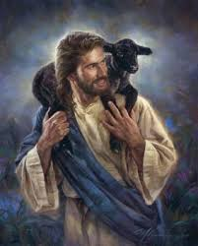
“Each of us should read and reread the parable of the lost sheep. … I hope the message of that parable will be impressed on the hearts of each of us.”

Slide 4
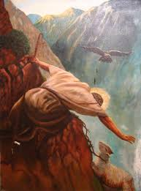
The parable of the lost sheep teaches us to seek after those who are lost.
The First Presidency [extended] to the membership of the Church a significant invitation … :“To those who have ceased activity and to those who have become critical, we say, ‘Come back. Come back and feast at the table of the Lord, and taste again the sweet and satisfying fruits of fellowship with the Saints.’“We are confident that many have longed to return, but have felt awkward about doing so. We assure you that you will find open arms to receive you and willing hands to assist you.” (Ensign, March 1986, p. 88.)

Slide 5
“Behold, he sendeth an invitation unto all men, for the arms of mercy are extended towards them, and he saith: Repent, and I will receive you.“Yea, he saith: Come unto me and ye shall partake of the fruit of the tree of life; yea, ye shall eat and drink of the bread and the waters of life freely;“Yea, come unto me and bring forth works of righteousness.” (Alma 5:33–35.

Slide 6
“What man of you, having an hundred sheep, if he lose one of them, doth not leave the ninety and nine in the wilderness, and go after that which is lost, until he find it?“And when he hath found it, he layeth it on his shoulders, rejoicing.“And when he cometh home, he calleth together his friends and neighbours, saying unto them, Rejoice with me; for I have found my sheep which was lost” [Luke 15:4–6]. …

Slide 7
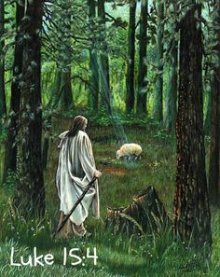

Slide 8
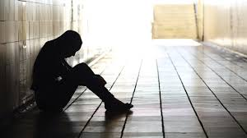
The Lord expects us to be His undershepherds and recover those who are struggling or lost.

Slide 9
What should we do to help those who have lost their way in the wilderness?
The Lord, our Good Shepherd, expects us to be his undershepherds and recover those who are struggling or are lost. We can’t tell you how to do it, but as you become involved and seek inspiration, success will result from efforts in your areas, … stakes, and wards.

Slide 10
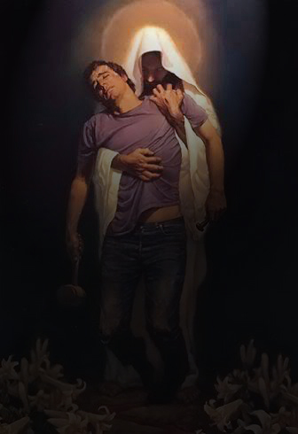
The words of a familiar hymn contain the Savior’s appeal to us:
Hark! he is earnestly calling,
Tenderly pleading today:
“Will you not seek for my lost ones,Off from my shelter astray?”
And that hymn, sung often, indicates what our response should be:
“Make us thy true undershepherds;
Give us a love that is deep.
Send us out into the desert,Seeking thy wandering sheep.”(Hymns, 1985, no. 221.)If we do this, eternal blessings will come to

Slide 11
Seeking after the lost, the wayward, and the straying is the Lord’s business. … The prayerful plea of Alma is a good reminder of the sacredness of our task:“O Lord, wilt thou grant unto us that we may have success in bringing [souls] again unto thee in Christ.“Behold, O Lord, their souls are precious.” (Alma 31:34–35.)

Slide 12
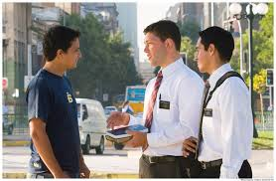
Our grand objective is to help people return to God’s presence.
Over the years the Church has made some monumental efforts to recover those who are less active. … And all to what end? It is to save the souls of our brothers and sisters and see that they have the ordinances of exaltation.

Slide 13
Success did not come immediately, but those who visited the home kept stressing the couple’s relationship with the Lord. In time she became friendly, and finally consented to come with her husband to the stake class taught by members of the high council. We stressed the covenant one makes at baptism and other covenants. Eventually she became a member of the Church and he became a productive priesthood leader. …

Slide 14
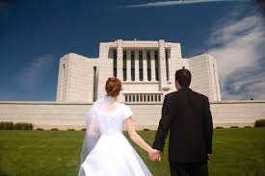
The whole purpose of the Church operating smoothly at the local level is to qualify individuals to return to the presence of God. That can only be done by their receiving the ordinances and making covenants in the temple.

Slide 15
We are leading toward one objective for each individual member of the Church. That is for all to receive the ordinances of the gospel and make covenants with our Heavenly Father so they may return to his presence. That is our grand objective. The ordinances and covenants are the means to achieving that divine nature that will return us into his presence again. …

Slide 16
I testify, my brethren and sisters, to his divinity and power to save those who will come to him with broken hearts and contrite spirits. Through the ordinances and his Holy Spirit, each individual may become clean.

