Slide 1
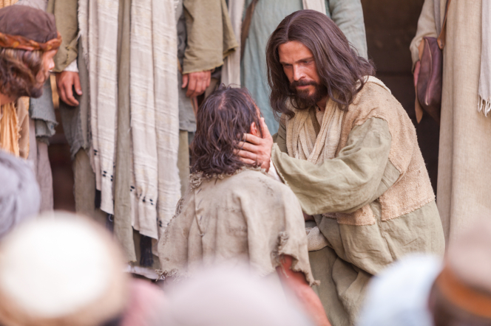
Chapter 11: True GREATNESS
“Giving consistent effort in the little things in day-to-day life leads to true greatness.”

Slide 2
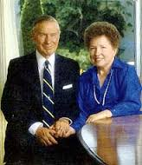
From the Life of Howard W. Hunter
True greatness comes not from worldly success but from “thousands of little deeds … of service and sacrifice that constitute the giving, or losing, of one’s life for others and for the Lord.”
Elder James E. Faust of the Quorum of the Twelve later said that President Hunter’s “tender loving care of his wife Claire for more than ten years while she was not well was the most noble devotion of a man to a woman that many of us have seen in our lives.”

Slide 3
“Though deep-seated modesty would prevent him from ever making the comparison, President Hunter met his own definition of greatness. His greatness emerged in periods of his life far from the spotlight as he made pivotal choices to work hard, to try again after failing, and to help his fellowman. Those attributes were reflected in his remarkable ability to succeed in endeavors as diverse as music, law, business, international relations, carpentry, and, above all, being a ‘good and faithful servant’ of the Lord [Matthew 25:21].

Slide 4
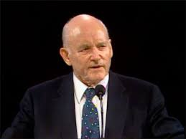
“For the fourteenth President of the Church, fulfilling the Lord’s purposes came as selflessly and naturally as had his labors as a schoolboy, a young father, a devoted bishop, and a tireless Apostle. The Lord’s vineyard, as Howard W. Hunter saw it, requires constant upkeep, and all that his Master required of him was to be a ‘good and faithful servant.’ This President Hunter fulfilled with true greatness, with constant attention to the example of the Savior, whom he served until the end.”

Slide 5
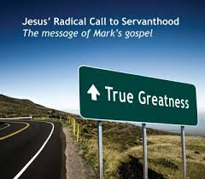
The world’s definition of greatness is often misleading and can prompt damaging comparisons.
Many Latter-day Saints are happy and enjoying the opportunities life offers. Yet I am concerned that some among us are unhappy. Some of us feel that we are falling short of our expect
Heb. 11:13–16; D&C 45:11–14.ed ideals.

Slide 6
What is true greatness? What is it that makes a person great?

Slide 7
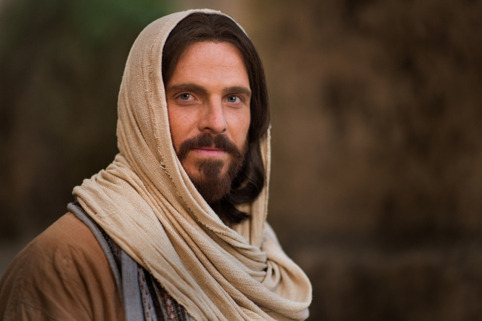
We live in a world that seems to worship its own kind of greatness and to produce its own kind of heroes. A recent survey of young people ages eighteen through twenty-four revealed that today’s youth prefer the “strong, go-it-alone, conquer-against-all-odds” individuals and that they clearly seek to pattern their lives after the glamorous and “boundlessly rich.”

Slide 8
Because we are being constantly exposed to the world’s definition of greatness, it is understandable that we make comparisons between what we are and what others are—or seem to be—and also between what we have and what others have. Although it is true that making comparisons can be beneficial and may motivate us to accomplish much good and to improve our lives, we often allow unfair and improper comparisons to destroy our happiness when they cause us to feel unfulfilled or inadequate or unsuccessful.

Slide 9
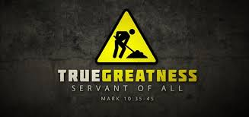
Giving consistent effort in the little things in day-to-day life leads to true greatness.

Slide 10
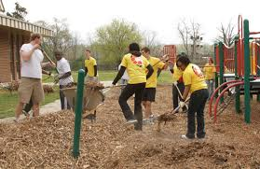
What are the things God has ordained to be “the common lot of all mankind”? Surely they include the things that must be done in order to be a good father or a good mother, a good son or a good daughter, a good student or a good roommate or a good neighbor.

Slide 11
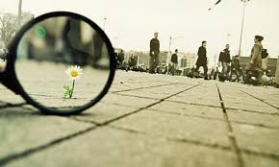
Giving consistent effort in the little things in day-to-day life leads to true greatness. Specifically, it is the thousands of little deeds and tasks of service and sacrifice that constitute the giving, or losing, of one’s life for others and for the Lord. They include gaining a knowledge of our Father in Heaven and the gospel.

Slide 12
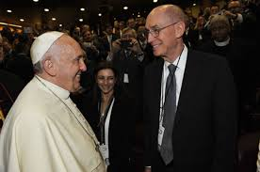
They also include bringing others into the faith and fellowship of his kingdom. These things do not usually receive the attention or the adulation of the world.

Slide 13
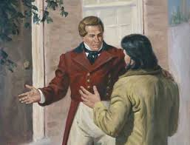
The Prophet Joseph was concerned with the daily tasks of service and caring for others.
Joseph Smith is not generally remembered as a general, mayor, architect, editor, or presidential candidate. We remember him as the prophet of the Restoration, a man committed to the love of God and the furthering of His work. The Prophet Joseph was an everyday Christian. He was concerned about the small things, the daily tasks of service and caring for others. As a thirteen-year-old boy, Lyman O. Littlefield accompanied the camp of Zion, which went up to Missouri.

Slide 14
True greatness comes from persevering in the difficulties of life and from serving in ways that are often unnoticed.
To be a successful elders quorum secretary or Relief Society teacher or loving neighbor or listening friend is much of what true greatness is all about. To do one’s best in the face of the commonplace struggles of life—and possibly in the face of failure—and to continue to endure and to persevere in the ongoing difficulties of life when those struggles and tasks contribute to others’ progress and happiness and one’s own eternal salvation—this is true greatness.

Slide 15
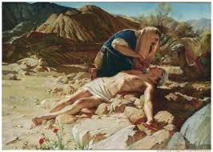

Slide 16
I am confident that there are many great, unnoticed, and forgotten heroes among us. I am speaking of those of you who quietly and consistently do the things you ought to do. I am talking about those who are always there and always willing. I am referring to the uncommon valor of the mother who, hour after hour, day and night, stays with and cares for a sick child while her husband is at work or in school.

Slide 17
I do not mean to discount the great accomplishments of the world that have given us so many opportunities and that provide culture and order and excitement in our lives. I am merely suggesting that we try to focus more clearly on the things in life that will be of greatest worth. You will remember that it was the Savior who said, “He that is greatest among you shall be your servant.” (Matt. 23:11.)

Slide 18
True greatness requires consistent, small, and sometimes ordinary steps over a long period of time.
Each of us has seen individuals become wealthy or successful almost instantaneously—almost overnight. But I believe that even though this kind of success may come to some without prolonged struggle, there is no such thing as instant greatness.
D&C 64:33
True greatness is never a result of a chance occurrence or a one-time effort or achievement. Greatness requires the development of character. It requires a multitude of correct decisions in the everyday choices between good and evil that Elder Boyd K. Packer spoke about when he said, “Over the years these little choices will be bundled together and show clearly what we value.”

Slide 19
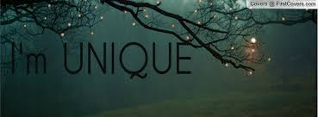
Commonplace tasks often have the greatest positive effect on others.
As we evaluate our lives, it is important that we look, not only at our accomplishments but also at the conditions under which we have labored.
We are each different and unique;
we have each had different starting points in the race of life;
we each have a unique mixture of talents and skills;
we each have our own set of challenges and constraints with which to contend.

Slide 20
Doing the things that God has ordained to be important will lead to true greatness.
It appears to me that the kind of greatness that our Father in Heaven would have us pursue is within the grasp of all who are within the gospel net.
The small things are significant. We remember not the amount offered by the Pharisee but the widow’s mite, not the power and strength of the Philistine army but the courage and conviction of David.

Slide 21
