Slide 1
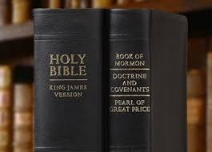
Chapter 10: The Scriptures—The Most Profitable of All Study
Related Scriptures
Joshua 1:8; Proverbs 30:5; 1 Nephi 15:23–24; 2 Nephi 3:12; Alma 31:5; 37:44; Helaman 3:29–30; D&C 98:11
“May each of us … draw closer to our Father in Heaven and his Beloved Son through consistent study of the holy scriptures.”

Slide 2
From the Life of Howard W. Hunter
President Howard W. Hunter had a great love for the scriptures and was a dedicated student of them. This love and study were reflected in his teachings, which were filled with stories and other passages from the standard works. Often when teaching a gospel principle, especially in general conference, he selected at least one story from the scriptures, told it in detail, and drew applications from it.

Slide 3
“We hope you are reading and studying the scriptures on a daily basis as individuals and as families.”

Slide 4
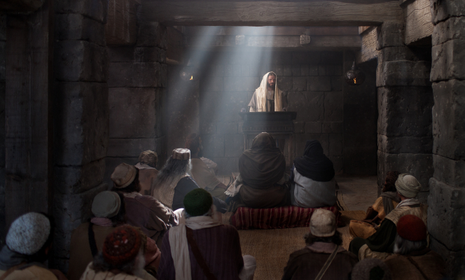
Studying the scriptures is the most profitable of all study in which we can engage.

Slide 5
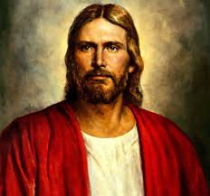
Central to all truth is the testimony that Jesus of Nazareth is the Christ, the Great Jehovah, the Savior of the World, and the Only Begotten Son of the Living God. This is the message of the scriptures. Throughout each of these holy books there is an appeal to believe and have faith in God the Eternal Father and in his Son, Jesus Christ; and from the first to the last of these books of scripture is the call to do the will of God and keep his commandments.

Slide 6
Studying the scriptures helps us learn and obey God’s will.
In order to be obedient to the law of the gospel and be obedient to the teachings of Jesus Christ, we must first understand the law and ascertain the will of the Lord. This is accomplished best by searching and studying the scriptures and the words of the prophets. In this way we become familiar with what God has revealed to man.

Slide 7
Scripture study “is the most profitable of all study in which we could engage.”

Slide 8
To understand the scriptures requires concentrated, consistent, prayerful study.
We urge each of you to carefully consider how much time you are currently giving to prayerful pondering of the scriptures.As one of the Lord’s servants, I challenge you to do the following:

Slide 9
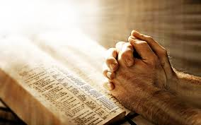
1. Read, ponder, and pray over the scriptures daily as individual members of the Church.

Slide 10
2. Hold family scripture reading on a regular basis. We commend those of you who are already doing this and urge those of you who have not yet started to begin doing so without delay.

Slide 11
Contemplating the brief scriptural account of Jairus brings a great depth of understanding and meaning
The life, acts, and teachings of Jesus can be read rapidly. The stories are simple in most instances and the stories are simply told. The Master used few words in his teachings, but each one is so concise in meaning that together they portray a clear image to the reader. Sometimes, however, many hours might be spent in contemplation of profound thoughts expressed in a few simple words.

Slide 12
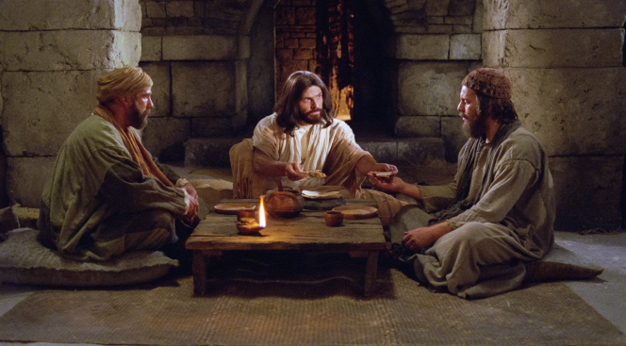

Slide 13
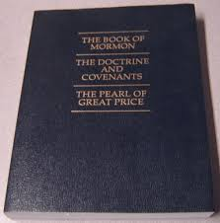
The Book of Mormon and Doctrine and Covenants will bring us closer to Christ.

Slide 14
The Book of Mormon
One of the most significant resources the Lord has provided to assist us in accomplishing this divine work is the Book of Mormon, subtitled “Another Testament of Jesus Christ.” [President Ezra Taft Benson] forthrightly admonished us not to neglect reading and abiding by the precepts of this sacred volume of scripture. “Its great mission,” he taught us, “is to bring men to Christ [and thus to the Father], and all other things are secondary.” (Ensign, May 1986, p. 105.) We hope you brothers and sisters are feeding your spirits by regularly reading the Book of Mormon and the other scriptures and using them in your ministries

Slide 15
The Doctrine and Covenants
The Doctrine and Covenants is a unique book. It is the only book on the face of the entire earth with a preface composed by the Creator himself. Furthermore, this book of scripture contains more direct quotations from the Lord than any other existing book of scripture.

Slide 16
