Slide 1
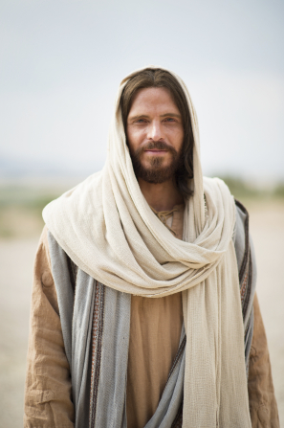
Chapter 1: Jesus Christ—Our Only Way to Hope and Joy
“If our lives and our faith are centered upon Jesus Christ and his restored gospel, nothing can ever go permanently wrong.”

Slide 2
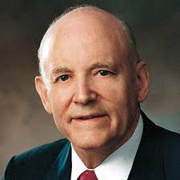
From the Life of Howard W. Hunter
True peace, healing, and happiness come only as a person strives to know and follow Jesus Christ. President Hunter taught that “Christ’s way is not only the right way, but ultimately the only way to hope and joy.

Slide 3
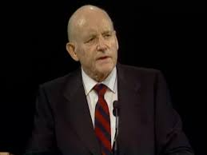
President Hunter was likewise bold in testifying of the Savior’s divine mission. “As an ordained Apostle and special witness of Christ, I give to you my solemn witness that Jesus Christ is in fact the Son of God,” he declared. “He is the Messiah prophetically anticipated by Old Testament prophets. He is the Hope of Israel, for whose coming the children of Abraham, Isaac, and Jacob had prayed during the long centuries of prescribed worship. …

Slide 4
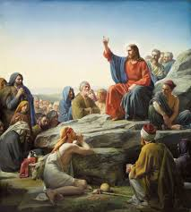
We must know Christ better than we know Him and remember Him more often than we remember Him.
How often do we think of the Savior? How deeply and how gratefully and how adoringly do we reflect on his life? How central to our lives do we know him to be?
Every day of our lives and in every season of the year … , Jesus asks each of us, as he did following his triumphant entry into Jerusalem those many years ago, “What think ye of Christ? whose son is he?” (Matt. 22:42.)

Slide 5
“May we be more devoted and disciplined followers of Christ. May we cherish him in our thoughts and speak his name with love.”
We must know Christ better than we know him; we must remember him more often than we remember him; we must serve him more valiantly than we serve him. Then we will drink water springing up unto eternal life and will eat the bread of life.

Slide 6
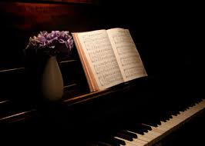
Jesus is our only true source of hope and lasting joy.
O hope of ev’ry contrite heart,O joy of all the meek,To those who fall, how kind thou art!How good to those who seek!
Contrition is costly—it costs us our pride and our insensitivity, but it especially costs us our sins. For, as King Lamoni’s father knew twenty centuries ago, this is the price of true hope. “O God,” he cried, “wilt thou make thyself known unto me, and I will give away all my sins to know thee … that I may be raised from the dead, and be saved at the last day.” (Alma 22:18.) When we, too, are willing to give away all our sins to know him and follow him, we, too, will be filled with the joy of eternal life.

Slide 7
Jesus, our only joy be thou, As thou our prize wilt be; Jesus, be thou our glory now, And thru eternity.

Slide 8
The greatest need in all the world is an active and sincere faith in the Savior and His teachings.
There are those who declare it is old-fashioned to believe in the Bible. Is it old-fashioned to believe in God, in Jesus Christ, the Son of the Living God? Is it old-fashioned to believe in his atoning sacrifice and the resurrection? If it is, I declare myself to be old-fashioned and the Church is old-fashioned. In great simplicity the Master taught the principles of life eternal and lessons that bring happiness to those with the faith to believe. It doesn’t seem reasonable to assume the necessity of modernizing these teachings of the Master. His message concerned principles that are eternal.

Slide 9
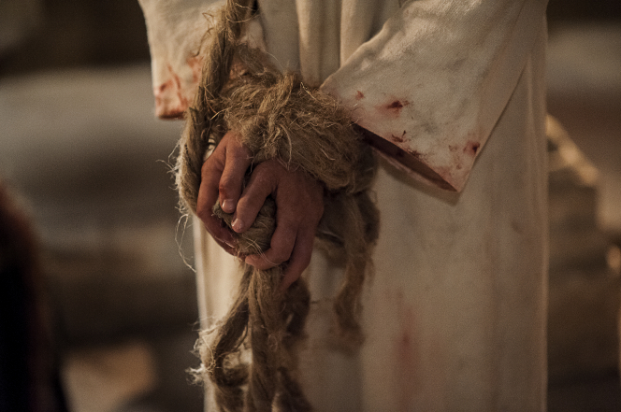
How are we supposed to act when we are offended, misunderstood, unfairly or unkindly treated, or sinned against? What are we supposed to do if we are hurt by those we love, or passed over for promotion, or are falsely accused, or have our motives unfairly assailed?

Slide 10
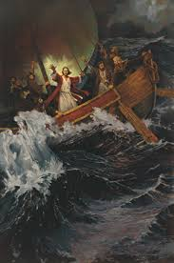
As we exercise faith in the Savior, He will calm the troubled waters of our lives
All of us have seen some sudden storms in our lives. A few of them … can be violent and frightening and potentially destructive. As individuals, as families, as communities, as nations, even as a church, we have had sudden squalls arise which have made us ask one way or another.

Slide 11
Jesus said, “In the world ye shall have tribulation: but be of good cheer; I have overcome the world.” (John 16:33.)
None of us would like to think we have no faith, but I suppose the Lord’s gentle rebuke here is largely deserved. This great Jehovah, in whom we say we trust and whose name we have taken upon us, is he who said, “Let there be a firmament in the midst of the waters, and let it divide the waters from the waters.” (Gen. 1:6.)

Slide 12
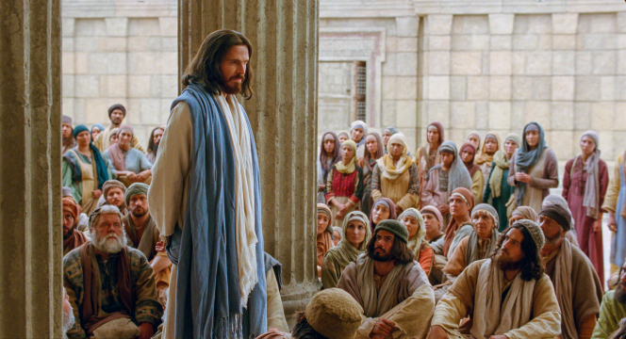
As we center our lives on the Savior, we need not fear, and our worries will be turned to joys.
I know enough about your busy and hectic lives to know that you sometimes get frustrated. You might even worry a little bit from time to time. I know all about that. …
“fear not, little flock.”
“and all things shall work together for your good” (D&C 90:24). I want to remind you of that promise. …

